Slide 1

INFLUENCING FACTORS TO THE ADOPTION OF CLOUD COMPUTING IN SRI LANKA

Slide 2

Research ID - IS-12 005
Researcher
A.G.L.N.Silva - IT 09 2053 76

Slide 3
CONTENT
INTRODUCTION
Background of the Research
Literature Review
Research Problem
RESEARCH OBJECTIVES
The Research Question
Main Objective
Sub Objectives
RESEARCH METHODOLOGY
Research Philosophy
Research Approach
Research Strategies
Type of research
Strategies of the research
Choice
Time Horizon
Data collection and data analysis methods

Slide 4
CONTENT cont..
SIGNIFICANT BENEFITS/MOTIVATIONS
Contribution to Sri Lanka
Contribution to Organizations
Contribution to IT Market Place
Contribution to the research team
LIMITATION
TIMELINE
CONCLUSION
END OF THE PRESENTATION

Slide 5

INTRODUCTION
Background of the Research
Focus area of the research
Introduction to Cloud Computing
A.G.L.N.Silva
IT 09 2053 76

Slide 6
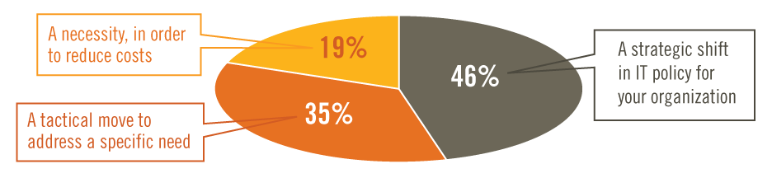
LITERATURE REVIEW
Figure:1 The way organizations describe their move to the Cloud Computing (global)
Source: Adoption, Approaches & Attitudes -The Future of Cloud Computing in the Public and Private Sectors : A Global Cloud Computing Study June 2011
A.G.L.N.Silva
IT 09 2053 76

Slide 7
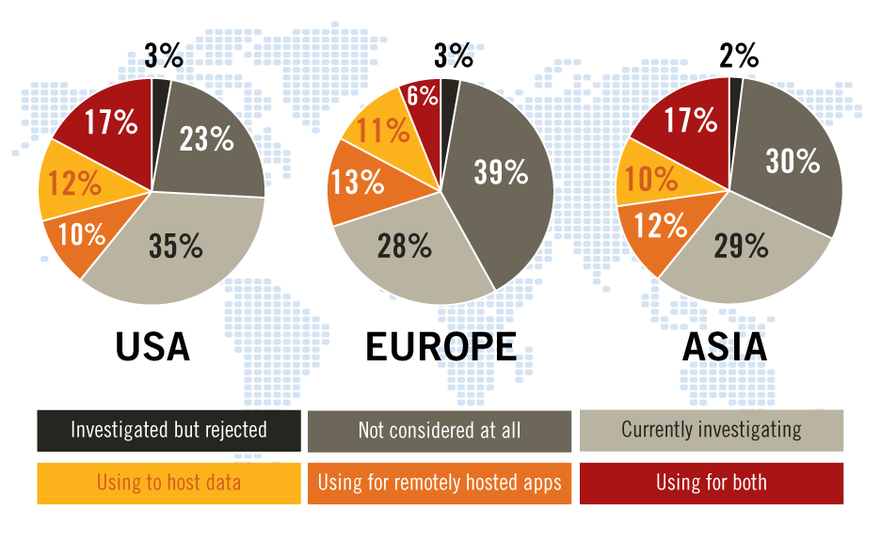
RESEARCH PROBLEM
Figure:2 Organization's Position In Relation To Cloud Computing, By Region
Source: Adoption, Approaches & Attitudes -The Future of Cloud Computing in the Public and Private Sectors : A Global Cloud Computing Study June 2011
A.G.L.N.Silva
IT 09 2053 76

Slide 8

OBJECTIVES

Slide 9
OBJECTIVE OF THE RESEARCH
The Research Question
What are the influencing factors to the adoption of cloud computing in Sri Lanka?
Main Objective
To investigate the influencing factors for adoption of cloud computing in Sri Lanka
The influencing factors to the adoption of cloud computing will be identified in three contexts.
Technological Factors
Organizational Factors
Environmental Factors.
A.G.L.N.Silva
IT 09 2053 76
Sri Lanka Institute of Information Technology

Slide 10
SUB OBJECTIVES
Sub Objective 1
To identify the Technological factors influence to the adoption of cloud computing in Sri Lanka
Sub Objective 2
To identify the Organizational factors influence to the adoption of cloud computing in Sri Lanka
Sub Objective 3
To identify the Environmental factors influence
to the adoption of cloud computing in Sri Lanka
A.G.L.N.Silva
IT 09 2053 76
Sri Lanka Institute of Information Technology

Slide 11

RESEARCH METHODOLOGY
A.G.L.N.Silva
IT 09 2053 76

Slide 12
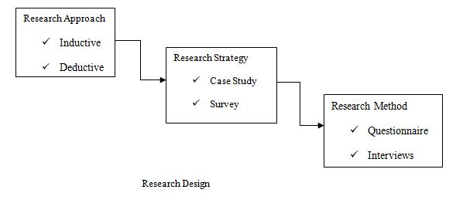
METHODOLOGY
Research Approach
- Inductive
- Deductive
Research Strategies
Type of research
Strategies of the research
Case study
Survey
Figure:4
A.G.L.N.Silva
IT 09 2053 76

Slide 13
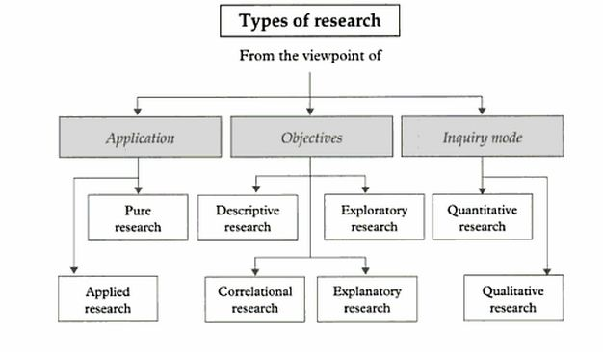
TYPES OF RESEARCH
Figure 3:Types of Research
Source: Research methodology: a step-by-step guide for beginners By Ranjit Kumar
A.G.L.N.Silva
IT 09 2053 76

Slide 14
METHODOLOGY cont..
Data Collection And Data Analysis Methods
Interviews
Questionnaires
Statistical Data Analysis
A.G.L.N.Silva
IT 09 2053 76
Sri Lanka Institute of Information Technology

Slide 15
SIGNIFICANT BENEFITS/MOTIVATIONS
Importance of the Research
Contribution to Sri Lanka
Contribution to Organizations
Contribution to IT Market Place
Contribution to the research team
A.G.L.N.Silva
IT 09 2053 76

Slide 16
LIMITATION
The research is conducted and analyzed further in the western region (Colombo, Gampaha, Kaluthara) of Sri Lanka
This is because most of the organizations which are using cloud computing are located in western province
Sri Lanka Institute of Information Technology

Slide 17
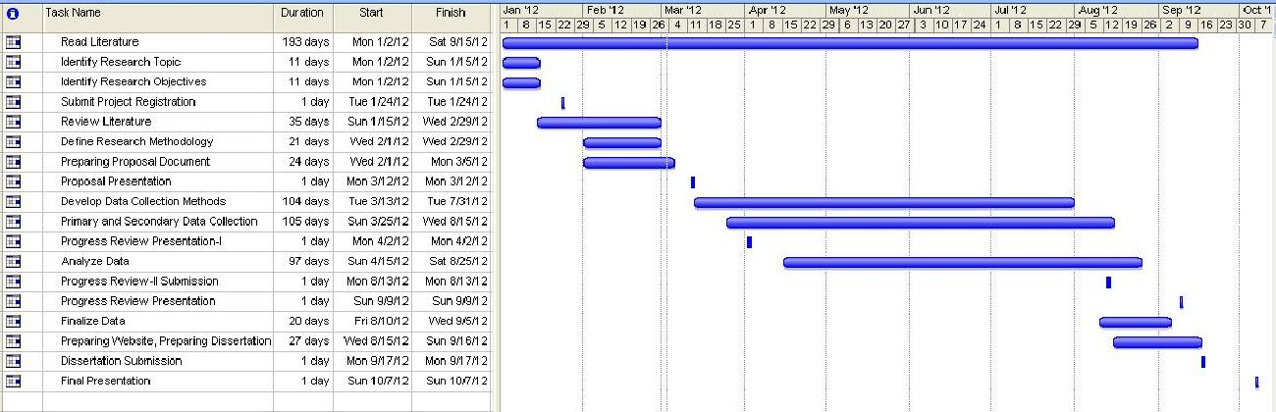
TIMELINE

Slide 18
CONCLUSION
The research is anticipated to identify the influencing factors to the adoption of cloud computing in Sri Lanka.
The research feasibility study is conducted to identify the reality of the project.
Through The Previous Researches The Research Gap Is Identified.
After identifying the research gap the objectives and sub objectives were formed to fill the identified research gap.
Sri Lanka Institute of Information Technology

Slide 19
CONCLUSION cont..
The objective and the sub objectives will be analyzed using the TOE frame work.
According to this frame work the factors influencing cloud computing will be identified in three major contexts, technological aspect, organizational aspect and environmental aspect.
The research team hopes to apply research methodologies for collect and analyze data.
The final outcome of this research is a conceptual model which indicates the influencing factors to the adoption of
cloud computing.
Sri Lanka Institute of Information Technology

Slide 20

Thank You
Sri Lanka Institute of Information Technology

